Slide 1


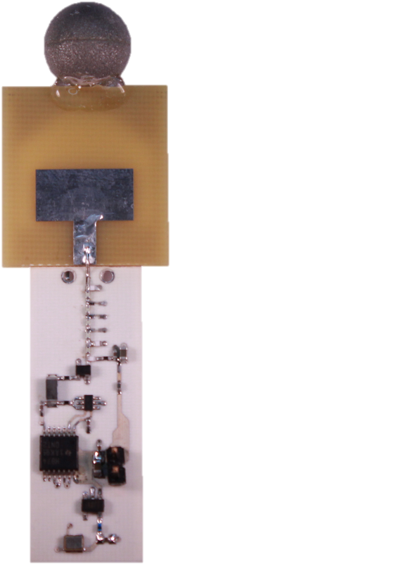
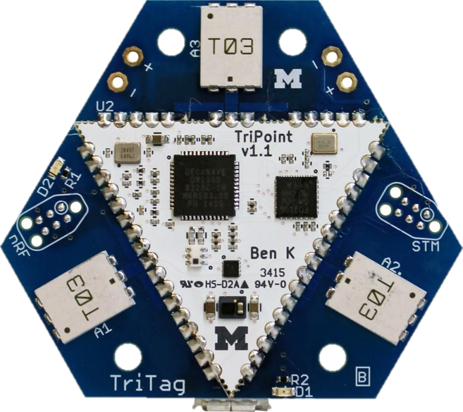
Ultra-Wideband and Indoor Localization
Pat Pannuto
In collaboration with Benjamin Kempke, Bradford Campbell, and Prabal Dutta
HotWireless’16
October 3, 2016, NYC, NY, USA
Notes:
[as submitted in advance]:
Title: PolyPoint and the First Steps Towards Ubiquitous Location
Abstract: In the not too distant future, location will be a fundamental primitive available to all devices, akin to a unique id, a sense of time, and basic communication. This talk briefly articulates why location is a natural and inevitable primitive, explores the definition of a location, and considers the state and evolution of localization technology today. The talk then introduces the PolyPoint localization platform, an up-and-coming drop-in module that aims to provide high-fidelity indoor location information.

Slide 2
Early RF-only localization (largely RSSI) had comparatively poor accuracy
2002
FCC allows unlicensed use of UWB spectrum
2005
International UWB regulations
2007
IEEE 802.15.4a
RF-Based
10.00
RADAR[‘00/2.94]
LANDMARC [‘04/2.00]
1.00
Accuracy (m)
Dolphin [‘04/0.24]
0.10
Cricket [‘00/0.10]
iBadge [‘02/0.10]
Ultrasonic
(or UL+RF)
0.01
1999
2002
2005
2008
2011
2014
2017
Time

Slide 3
What is Ultra-Wideband?
Time Domain
Frequency Domain
5.31 GHz
5.33 GHz
Narrowband
5 GHz
6 GHz
Ultra-Wideband
Notes:
Add in frequency domain duals

Slide 4
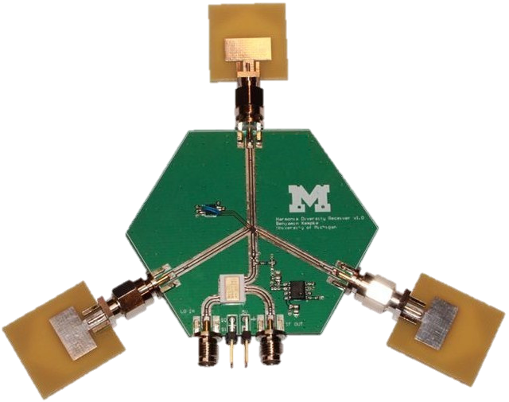
Indoors, reflections make time-of-flight estimation difficult and inaccurate

Slide 5
UWB can better disambiguate multipath and identify signal arrival time

Slide 6
Highly accurate (RF-based) indoor localization technology has arrived
10.00
Social fMRI [‘11/5.00]
RADAR[‘00/2.94]
Salathé [‘10/2.00]
LANDMARC [‘04/2.00]
WREN [‘13/2.00]
1.00
WASP [‘11/0.50]
Harmonia [‘14/0.40], RF-IDraw [‘14/0.38]
Accuracy (m)
PolyPoint [‘15/0.31]
Dolphin [‘04/0.24]
SurePoint [‘16/0.29]
0.10
Cricket [‘00/0.10]
Tagoram [‘14/0.12], WiTrack [‘14/0.12]
iBadge [‘02/0.10]
Harmonium [‘16/0.09]
Opo [‘14/0.05]
0.01
3D-LOCUS [‘09/<0.01]
1999
2002
2005
2008
2011
2014
2017
Time

Slide 7
UWB technologies have driven success in high-fidelity RF-based localization
2015
UWB-Based
UWB-based entries beginning to dominate IPSN localization competition
Half of competing teams achieved sub-meter accuracy
Takeaway: accuracy is a “solved” problem
2016
D. Lymberopoulos, J. Liu, X. Yang, A. Naguib, A. Rowe, N. Trigoni, and N. Moayeri. Microsoft Indoor Localization Competition – IPSN 2015.
D. Lymberopoulos, J. Liu, Y. Zhang, P. Dutta, X. Yang, A. Rowe, V. Dequeira. Microsoft Indoor Localization Competition – IPSN 2016.

Slide 8
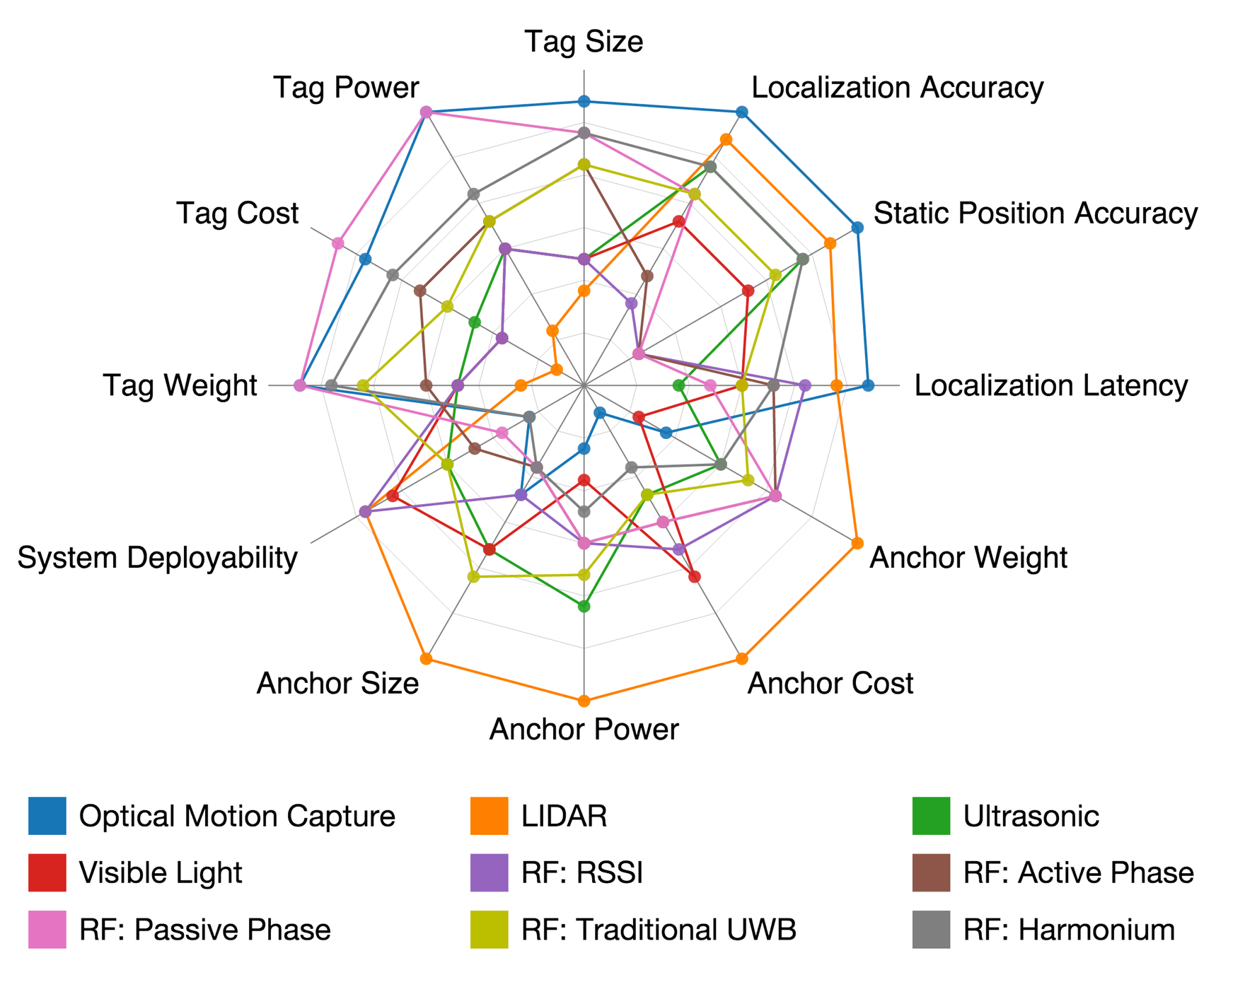
Accuracy is only one facet of localization, and has reached “good enough”
Here are 12 dimensions
Covering 9 technologies
Each have several implementations
(bigger is better) →
No one technology will fit all applications
What does it mean to localize a person to 1cm?
Motion? Walls? More??
Notes:
Radar plot doesn’t even show through walls!

Slide 9
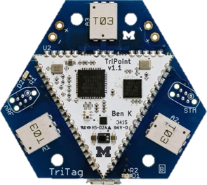

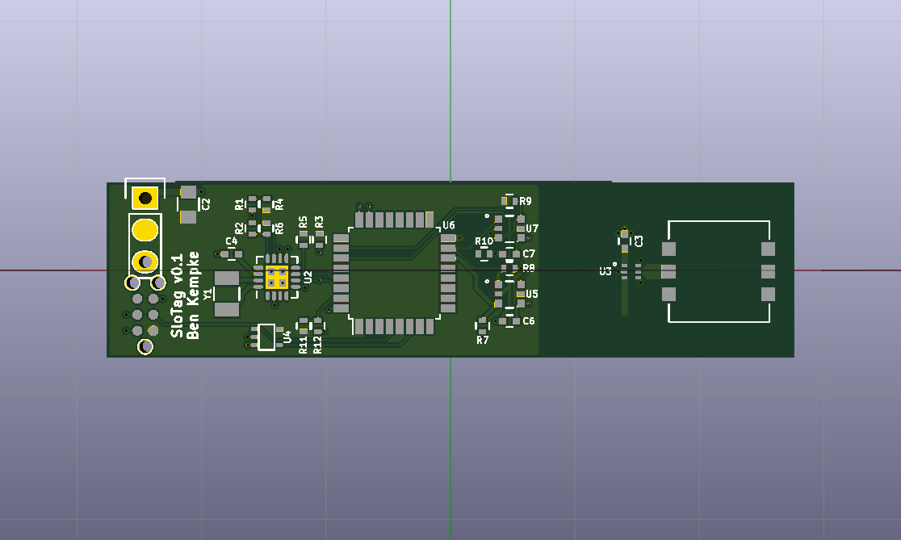
This talk: New UWB-based systems that go beyond accuracy
(Though, all are highly [10-30 cm] accurate)
SurePoint [SenSys’16]
Robust, scalable, and reliable
53 cm 99th percentile error
Harmonium [IPSN’16]
Inexpensive, low-power, lightweight
Localizes quadcopters with 5 g payload limit
Slocalization [in progress]
Lowest power and massively scalable

Slide 10
SurePoint: Time-of-Flight between symmetric tag and anchor nodes

Slide 11
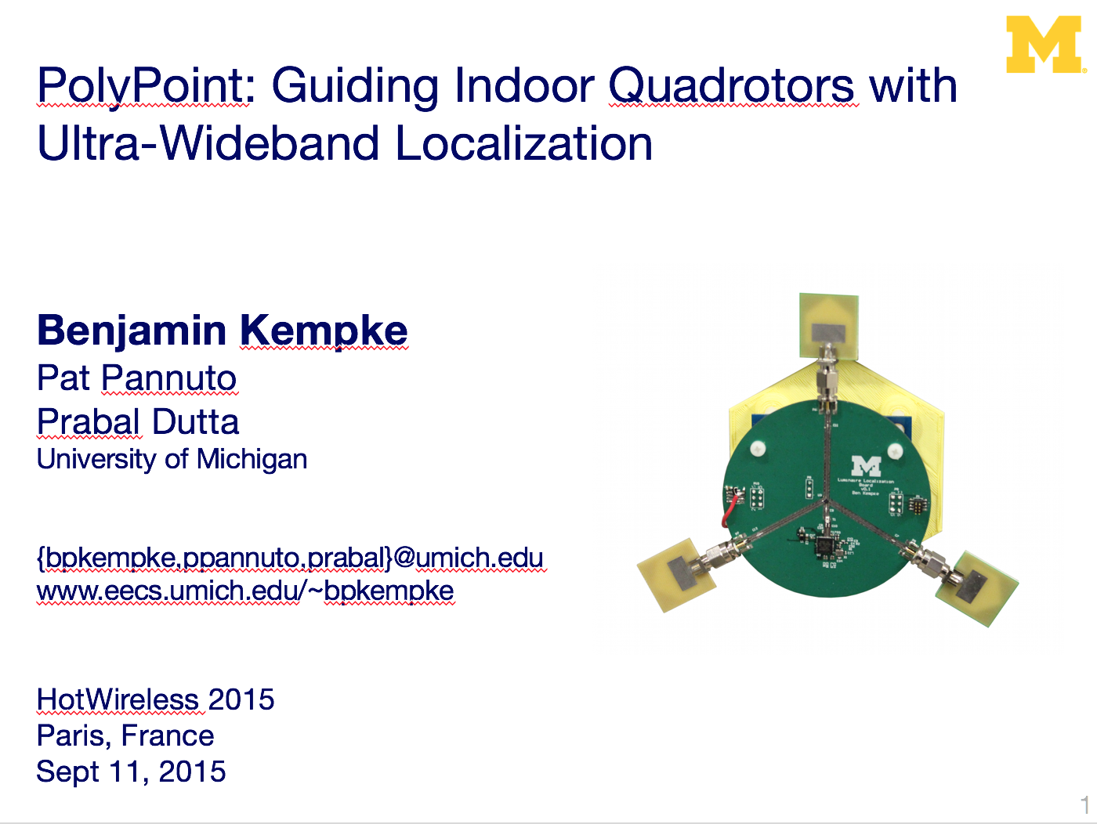
PolyPoint showed how to make commercial UWB accurate, SurePoint makes it usable
PolyPoint/SurePoint key innovations:
Exploit UWB channel diversity
^Efficiently with a broadcast-based ranging protocol
UWB constructive interference to schedule and scale
PolyPoint: Guiding Indoor Quadrotors with Ultra-Wideband Localization (HotWireless’15)
SurePoint: Exploiting Ultra Wideband Flooding and Diversity to Provide Robust, Scalable, High-Fidelity Indoor Localization (SenSys’16)
Benjamin Kempke, Pat Pannuto, Bradford Campbell, and Prabal Dutta

Slide 12

PolyPoint taught us that the UWB channel exhibits high variance
Channel model
27 Samples → 1 Range
Empirical Study
12th %ile Estimate
PolyPoint: Guiding Indoor Quadrotors with Ultra-Wideband Localization (HotWireless’15)
SurePoint: Exploiting Ultra Wideband Flooding and Diversity to Provide Robust, Scalable, High-Fidelity Indoor Localization (SenSys’16)
Benjamin Kempke, Pat Pannuto, Bradford Campbell, and Prabal Dutta

Slide 13
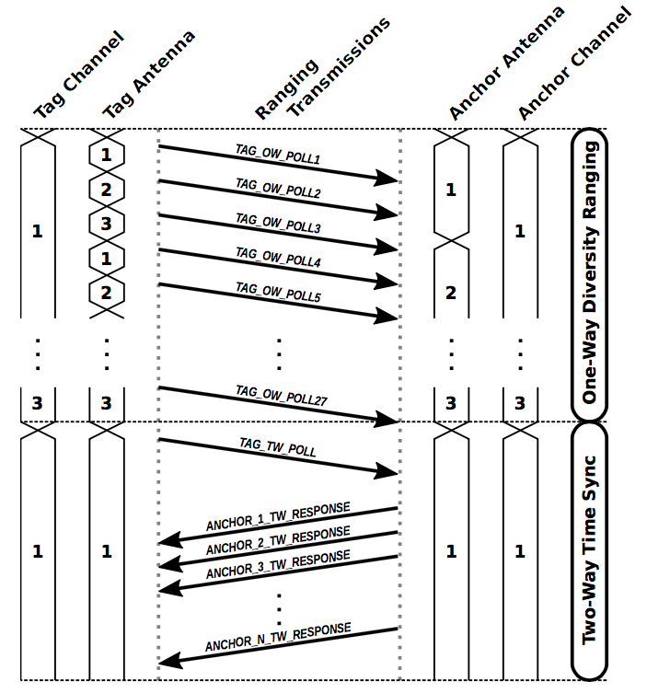
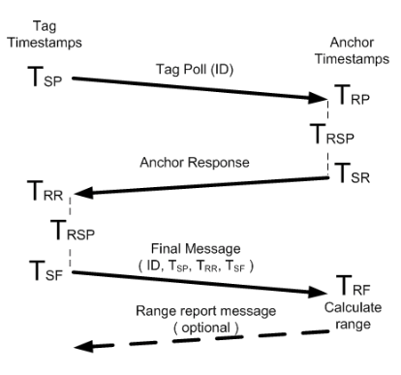
Broadcasts can make diversity acquisition efficient, but must also be robust
Problem:
In an open 20x20 m room with 16 anchors, PolyPoint ranges with an average of 4 each round
In the same room, SurePoint ranges with 7.3 of 9 deployed anchors
Naïve implementation: 27x3xN packets
PolyPoint: 27+1+N packets
SurePoint: 27+3+N packets
3 anchors:
243 packets (~4 Hz)
3 anchors:
31 packets (~32 Hz)
3 anchors:
33 packets (~31 Hz)
Notes:
Mention where 3 comes from (N)
20 Hz number needs to be here – (naïve system gets XYZ Hz)

Slide 14
Localizing multiple devices requires coordination to avoid interference
Insight: Borrow scheduling from sensor networking
State of the art relies on constructive interference – UWB friendly?
A
I
B
New Tradeoffs:
Number of tags vs. update rate
Join latency vs. update rate
PolyPoint: Guiding Indoor Quadrotors with Ultra-Wideband Localization (HotWireless’15)
SurePoint: Exploiting Ultra Wideband Flooding and Diversity to Provide Robust, Scalable, High-Fidelity Indoor Localization (SenSys’16)
Benjamin Kempke, Pat Pannuto, Bradford Campbell, and Prabal Dutta

Slide 15
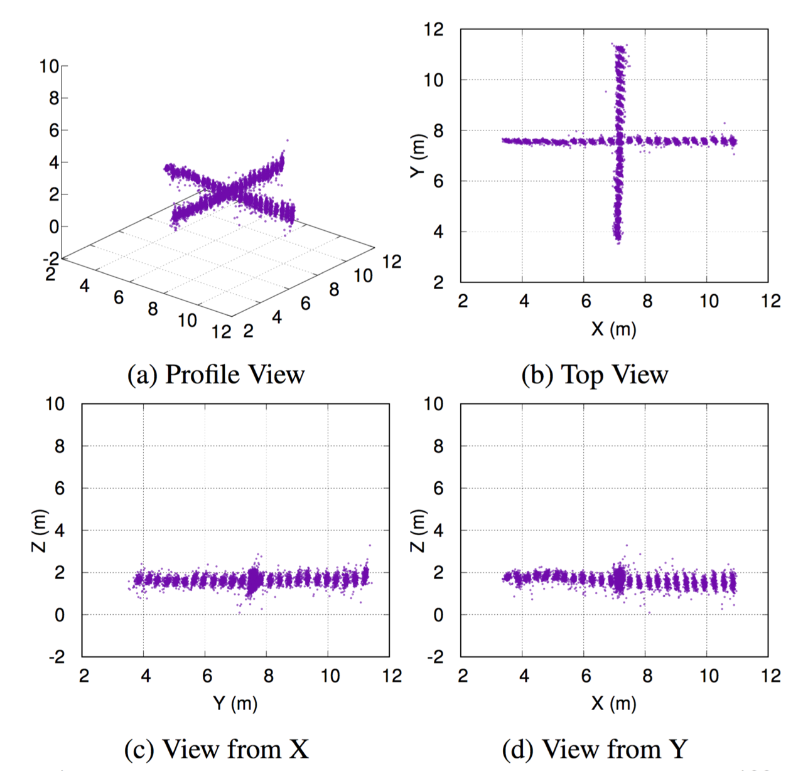
Robust, accurate localization and best-in-class long-tail performance
Stationary Experiment
7,500 samples
0.29 m median error
0.77 m 99th percentile error
1.53 m worst case error
0.76 m with 3-point median filter
Recovered range in every eligible round
PolyPoint: Guiding Indoor Quadrotors with Ultra-Wideband Localization (HotWireless’15)
SurePoint: Exploiting Ultra Wideband Flooding and Diversity to Provide Robust, Scalable, High-Fidelity Indoor Localization (SenSys’16)
Benjamin Kempke, Pat Pannuto, Bradford Campbell, and Prabal Dutta

Slide 16

SurePoint Today: Providing localization as a drop-in, modular primitive
TriPoint
Drop-in localization module
Towards “where-am-I” as an I²C command
TriTag
Carrier board
Adds BLE for offloading position information
PolyPoint: Guiding Indoor Quadrotors with Ultra-Wideband Localization (HotWireless’15)
SurePoint: Exploiting Ultra Wideband Flooding and Diversity to Provide Robust, Scalable, High-Fidelity Indoor Localization (SenSys’16)
Benjamin Kempke, Pat Pannuto, Bradford Campbell, and Prabal Dutta

Slide 17
SurePoint design is limited by the use of a commercial UWB transceiver
Economic cost
~$10 at quantity 1,000
Energy cost
280 mW
Flexibility
802.15.4a conflates time-of-flight ranging and data transmission

Slide 18
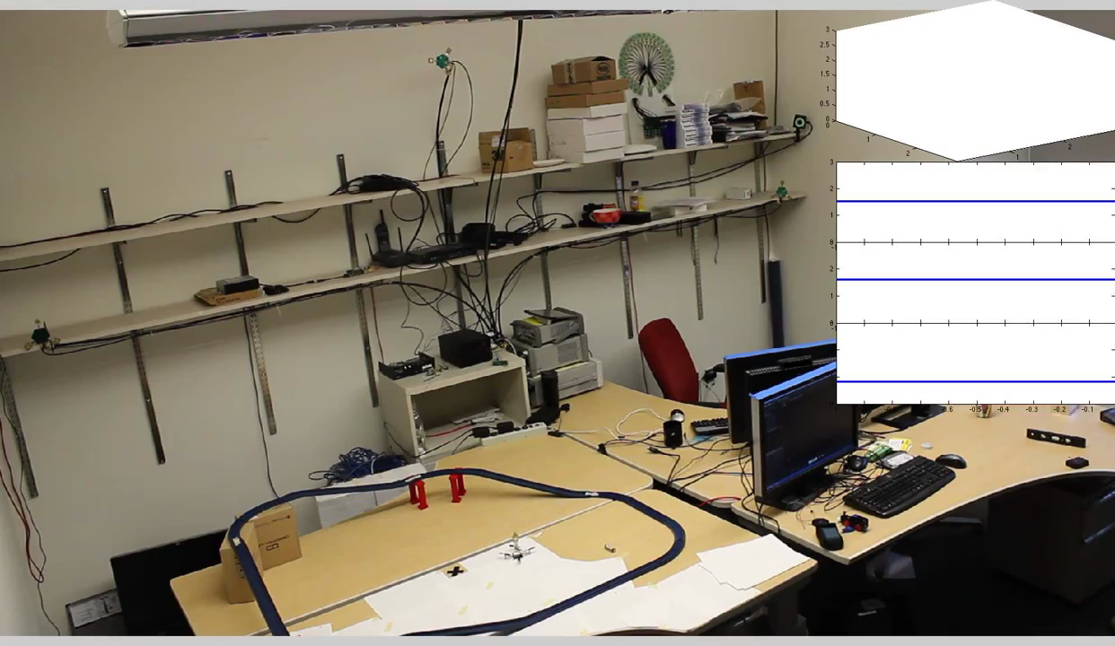
Harmonium: Decouple ranging and data to realize low-power, high-speed, high-fidelity tracking
Tag weighs 3g and costs ~$4.50
Draws 75mW transmitting, 3.9mJ / fix
14cm median 31cm 90%ile
Key tradeoff is asymmetry
Harmonia: Wideband Spreading for Accurate Indoor RF Localization (HotWireless’14)
Harmonium: Asymmetric, Bandstitched UWB for Fast, Accurate, and Robust Indoor Localization (IPSN’16)
Benjamin Kempke, Pat Pannuto, and Prabal Dutta

Slide 19
Insight: The harmonics of a sharp pulse are a UWB signal (thus, “Harmonium”)
Concept of operation:
BJT NPN Pulse generator
Monoflop generator
Pulse Repetition Frequency (PRF) generator
Trigger filter
Pulse-shaping filter
5 GHz
6 GHz

Slide 20
Pulse train generation
Notes:
Notes: Uses ASE-4.000MHZ-LC-T (+/- 50 ppm)

Slide 21
Pulse train generation

Slide 22
Pulse train generation

Slide 23
Pulse train generation

Slide 24
Pulse train generates a UWB signal
Pulse w/o filtering

Slide 25
Nit: filter input trigger
Pulse w/o filtering → Pulse w/ trigger filtering

Slide 26
UWB spectral mask starts at 3.1 GHz
Pulse w/o filtering → Pulse w/ trigger filtering

Slide 27
The Harmonium signal for $4.50 and 75 mW
Pulse w/o filtering → Pulse w/ trigger filtering → Pulse w/ shaping filter

Slide 28
Measure the time-difference-of-arrival to estimate the location of the tag
Anchor-global, synchronized clock
Commercial UWB receivers expect standard packets and modulation

Slide 29
Harmonium: UWB Reception with Narrowband Radios
Concept of operation:
Generic narrowband receiver
Frequency-swept local oscillator
Antenna diversity

Slide 30
Harmonium: UWB Reception with Narrowband Radios
Concept of operation:
Generic narrowband receiver
Frequency-swept local oscillator
Antenna diversity

Slide 31
Harmonium: UWB Reception with Narrowband Radios
Concept of operation:
Generic narrowband receiver
Frequency-swept local oscillator
Antenna diversity

Slide 32
Harmonium: UWB Reception with Narrowband Radios
Concept of operation:
Generic narrowband receiver
Frequency-swept local oscillator
Antenna diversity

Slide 33
Harmonium: UWB Reception with Narrowband Radios
Concept of operation:
Generic narrowband receiver
Frequency-swept local oscillator
Antenna diversity

Slide 34
Harmonium reconstructing UWB signals in the real world

Slide 35
Time-of-arrival estimation from a real-world trace

Slide 36
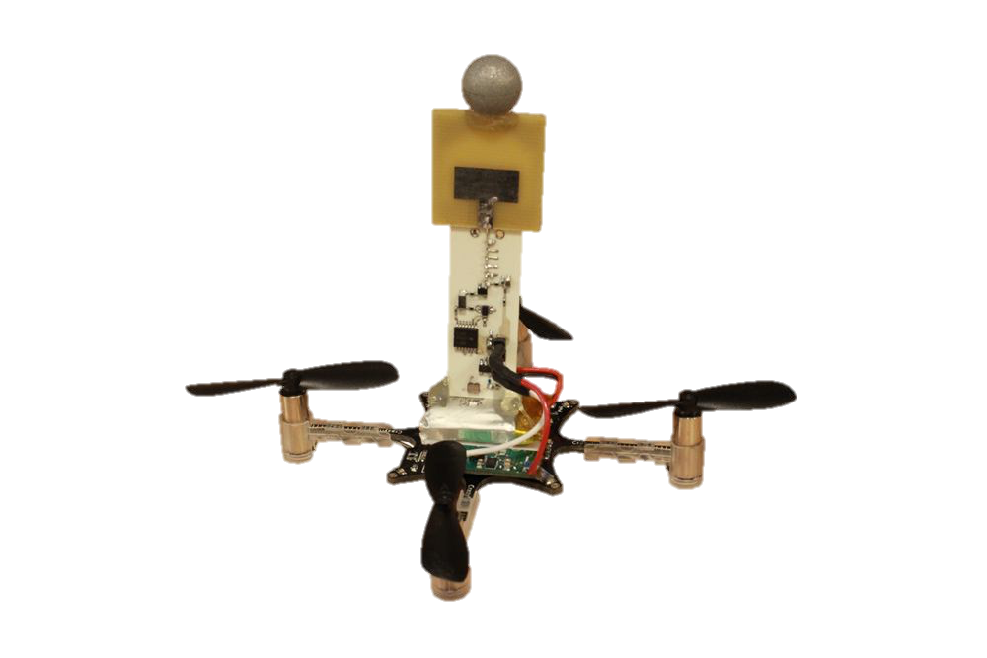
Harmonium successfully tracks micro quad-rotors accurately and with minimal impact
14 cm median error
46 cm 95%ile error
Up to 1.4 m/s
19 Hz sampling

Slide 37

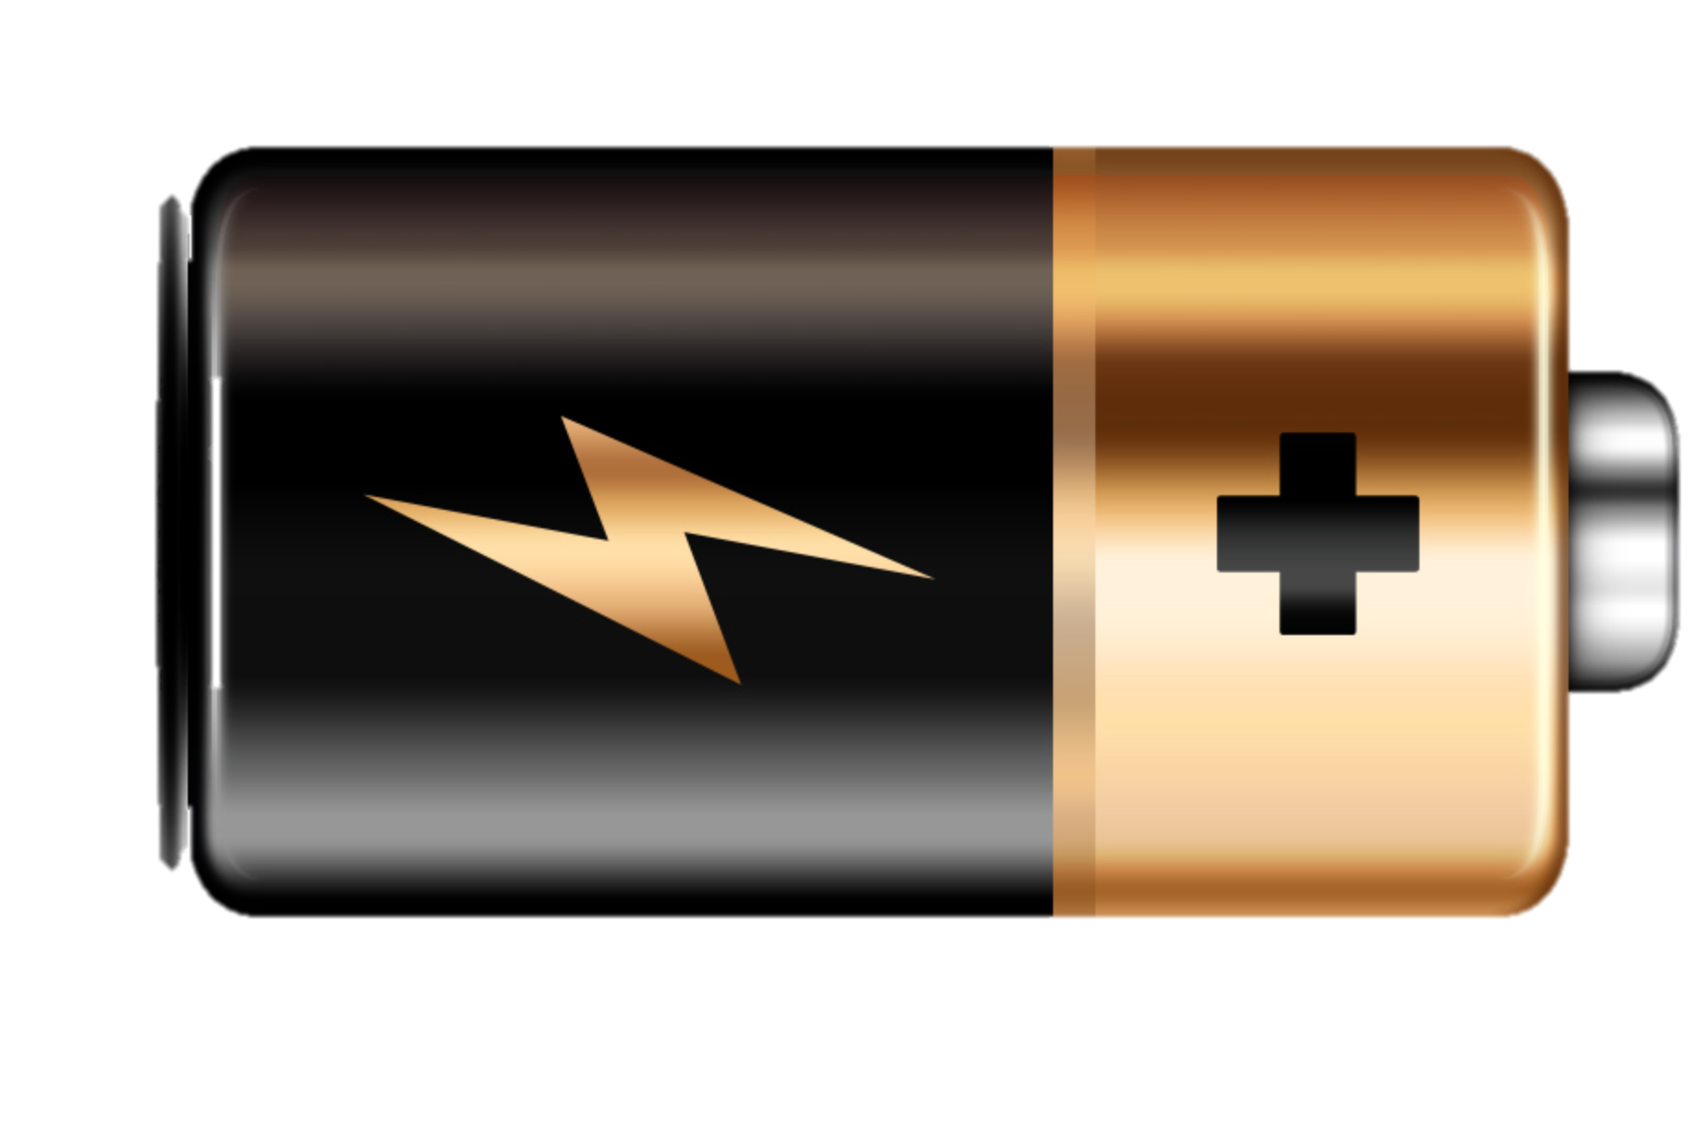
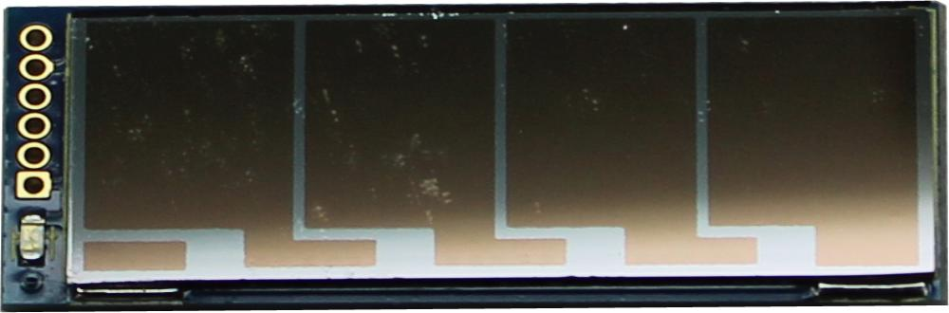
SurePoint lasts at best a few hours, Harmonium a few days – can we do better?
How might an energy-harvesting localization system work?

Slide 38
Slocalization: Backscatter-based UWB localization
Energy-harvesting tag drives PN code through a shift register loading/unloading an antenna
Well below noise floor, but integration in a static environment can reveal the tag signal
Longer PN code → more tags & slower localization

Slide 39
We are only beginning to scratch the surface of the UWB localization space
SurePoint
Robust, reliable, with excellent long-tail performance
Harmonium
Lower tag energy, area, and cost but anchor sync hinders deployment
Slocalization
Vastly lowest energy, but update rates in the minutes / fix
Other opportunities…
Solve for anchor positions, no measuring?
SurePoint tags range in parallel, eavesdropping?
UWB CIR underutilized?

Slide 40
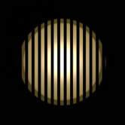
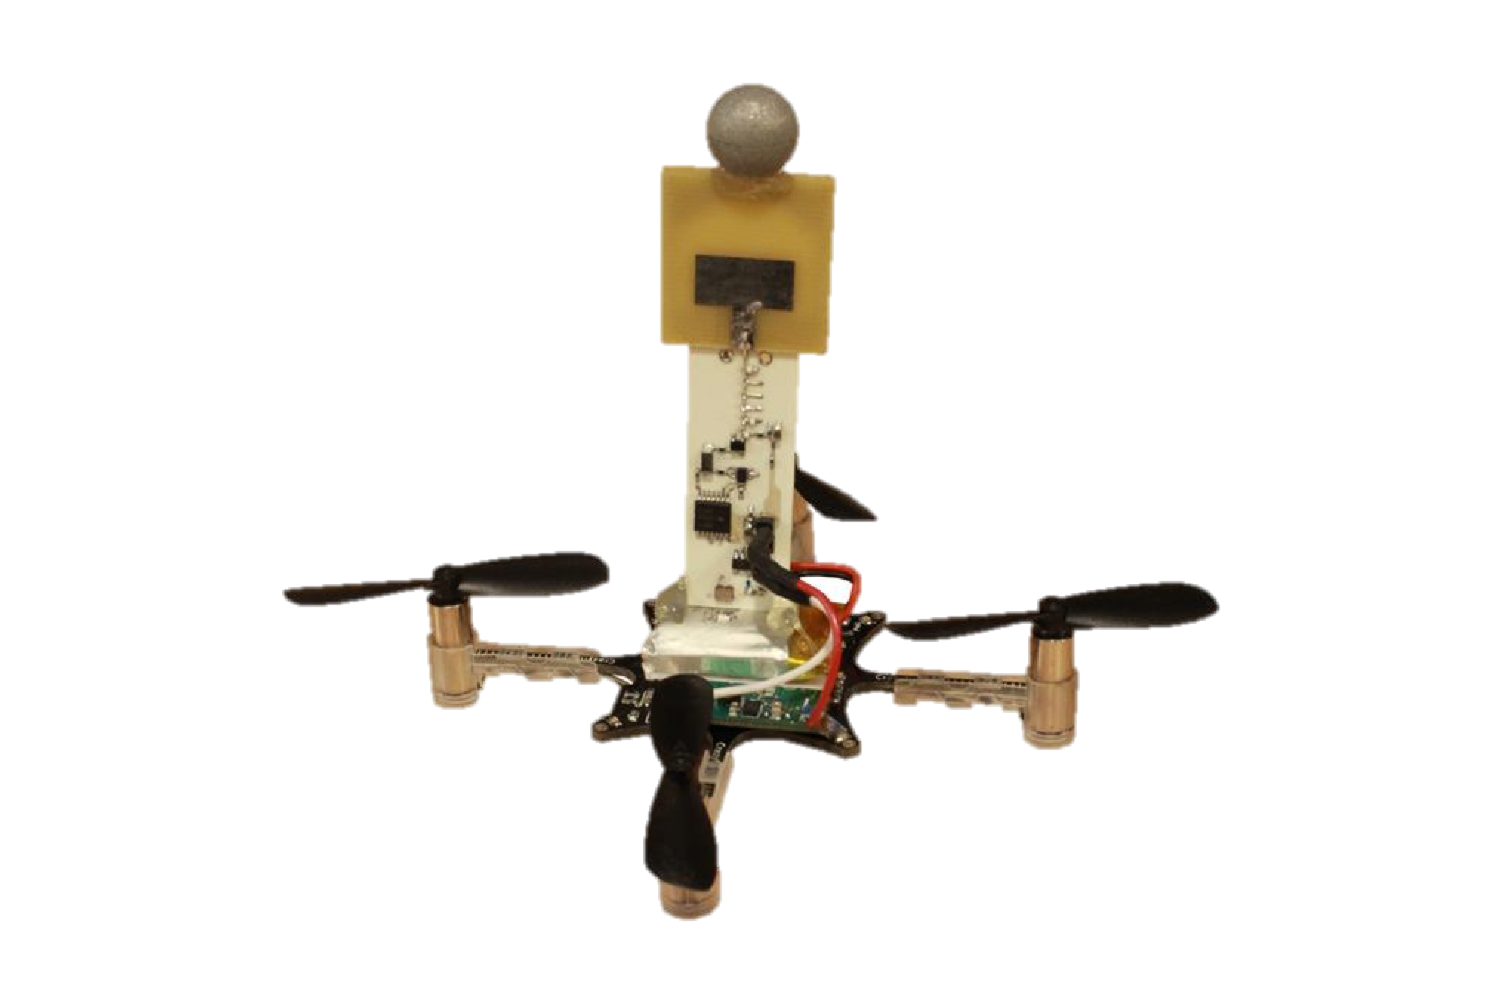
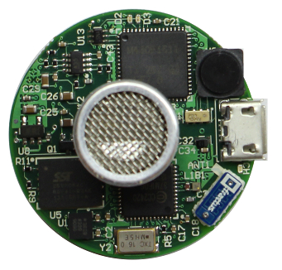
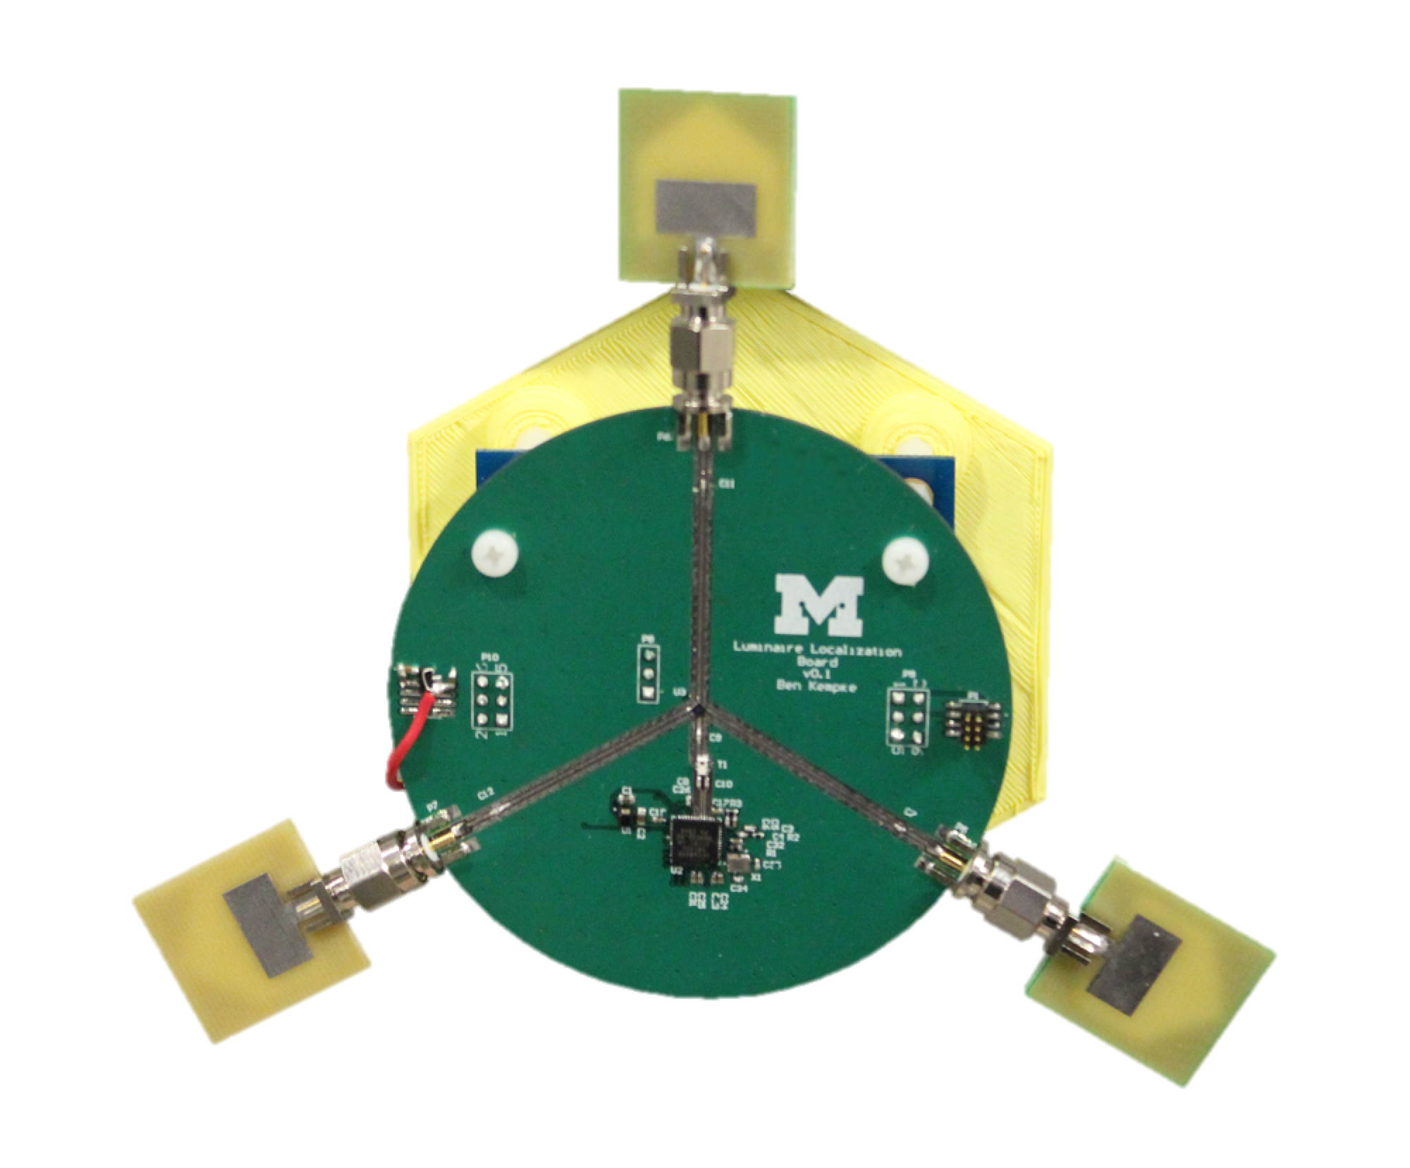
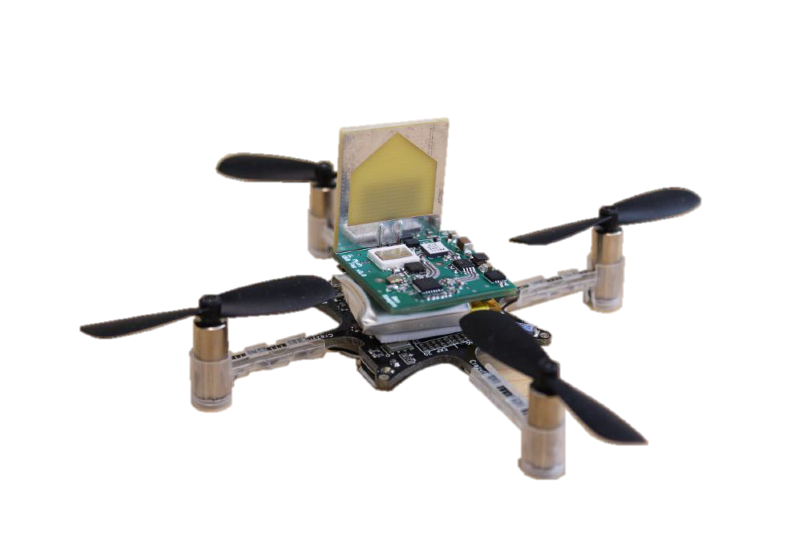
For More Information…
http://github.com/lab11
lab11/fast-square [harmonium]
lab11/polypoint [SurePoint]
http://patpannuto.com
Notes:
Our lab website is down. Lame ☹

Slide 41
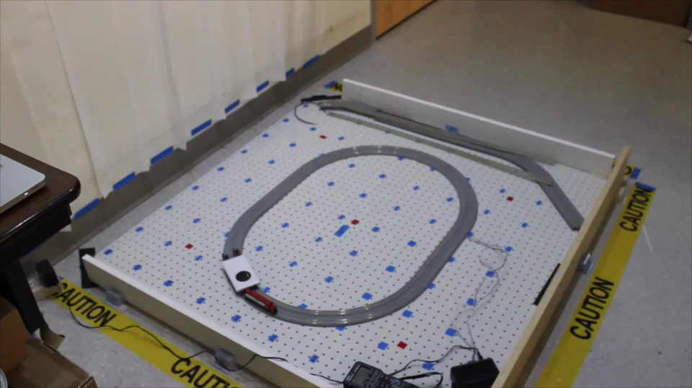
Luxapose: Astral navigation with smart phones and smart lights
Luxapose: Indoor Positioning with Mobile Phones and Visible Light (MobiCom’14)
Ye-Sheng Kuo, Pat Pannuto, Ko-Jen Hsiao, and Prabal Dutta

Slide 42
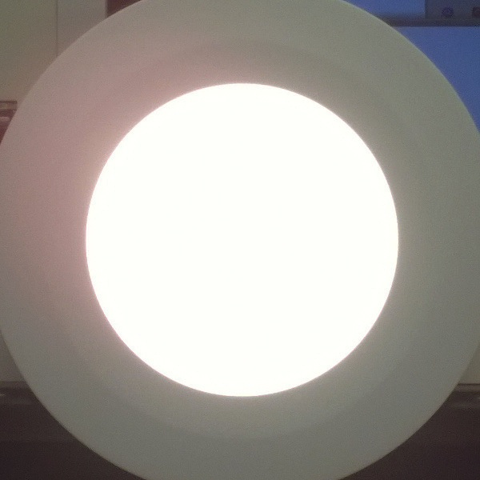
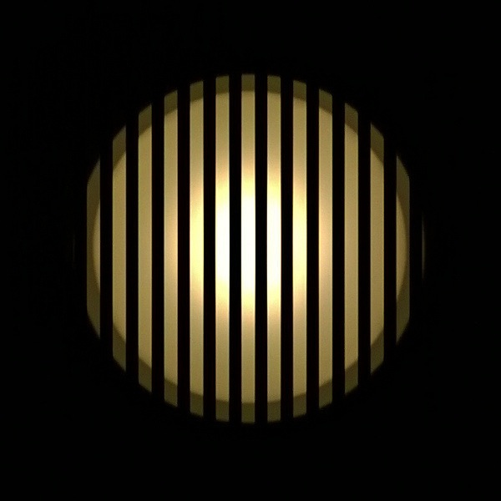
Luxapose enables high-fidelity indoor localization with impending infrastructure
Human Perception
Decimeter-level accuracy
Unmodified smartphones
Trivially modified LED lights
Camera Perception
Luxapose: Indoor Positioning with Mobile Phones and Visible Light (MobiCom’14)
Ye-Sheng Kuo, Pat Pannuto, Ko-Jen Hsiao, and Prabal Dutta

Slide 43
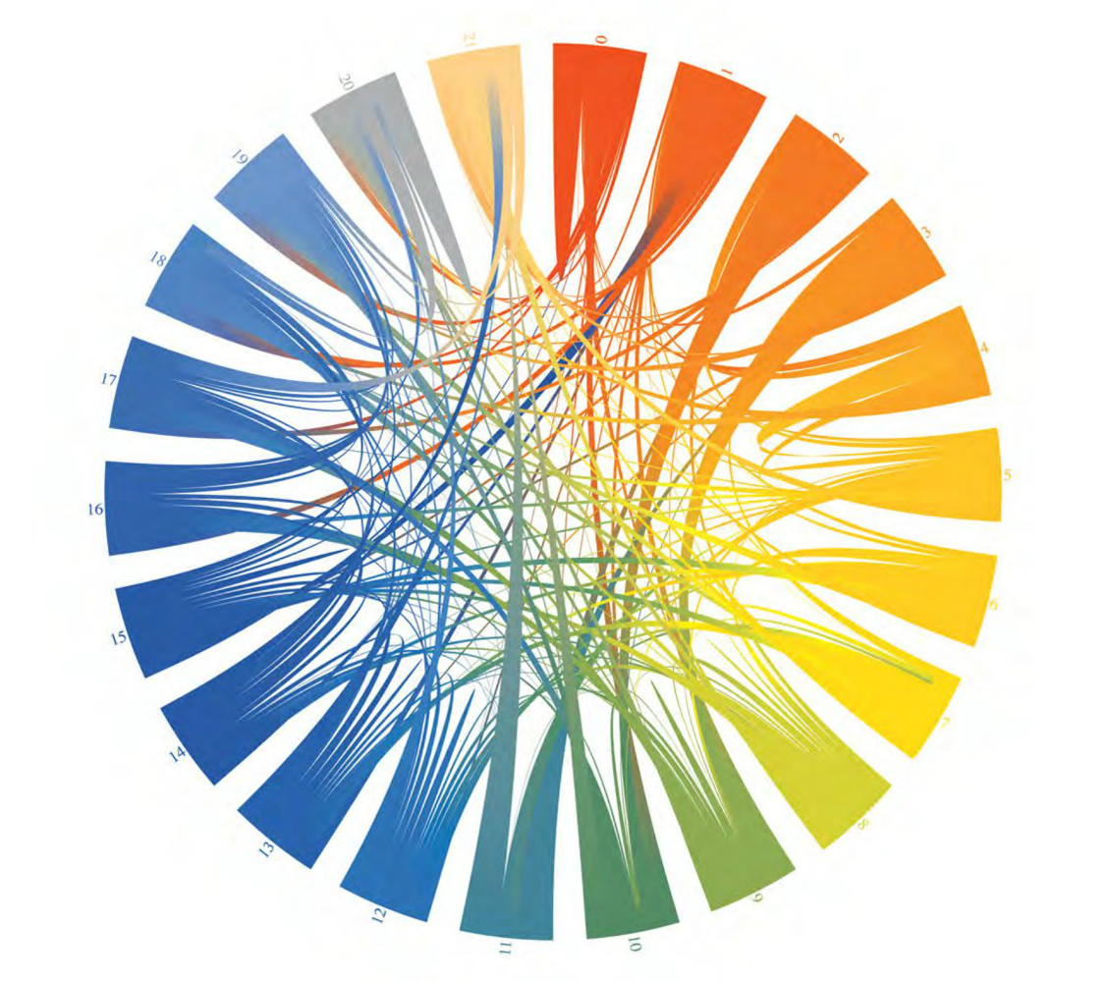
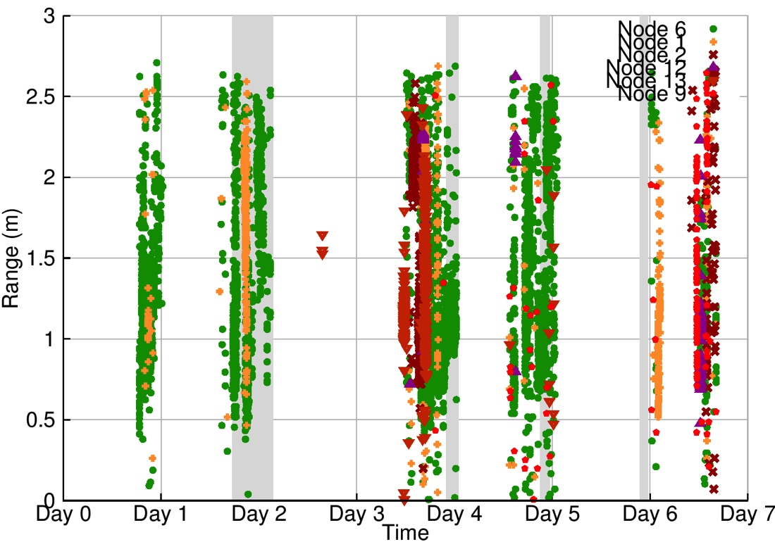
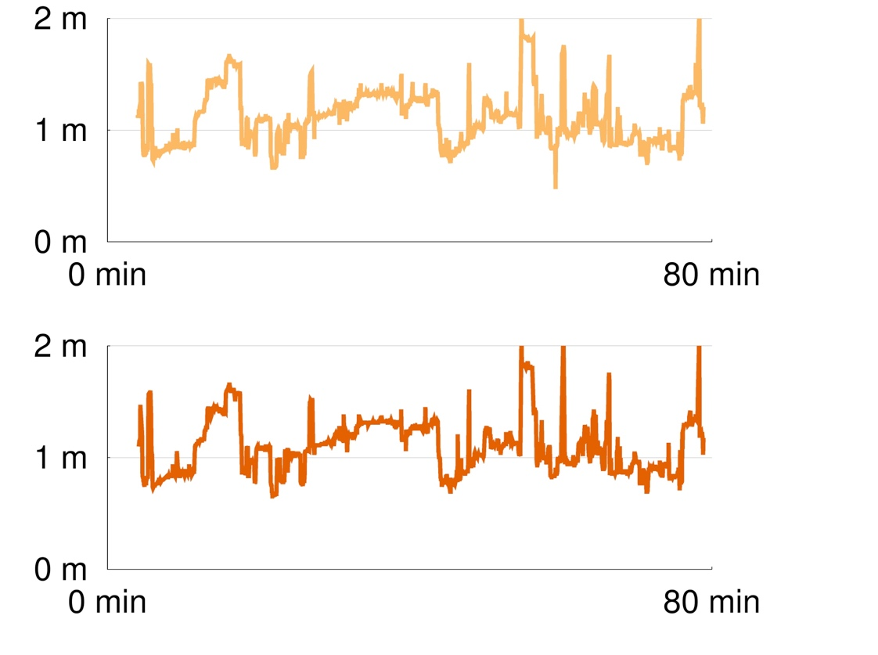
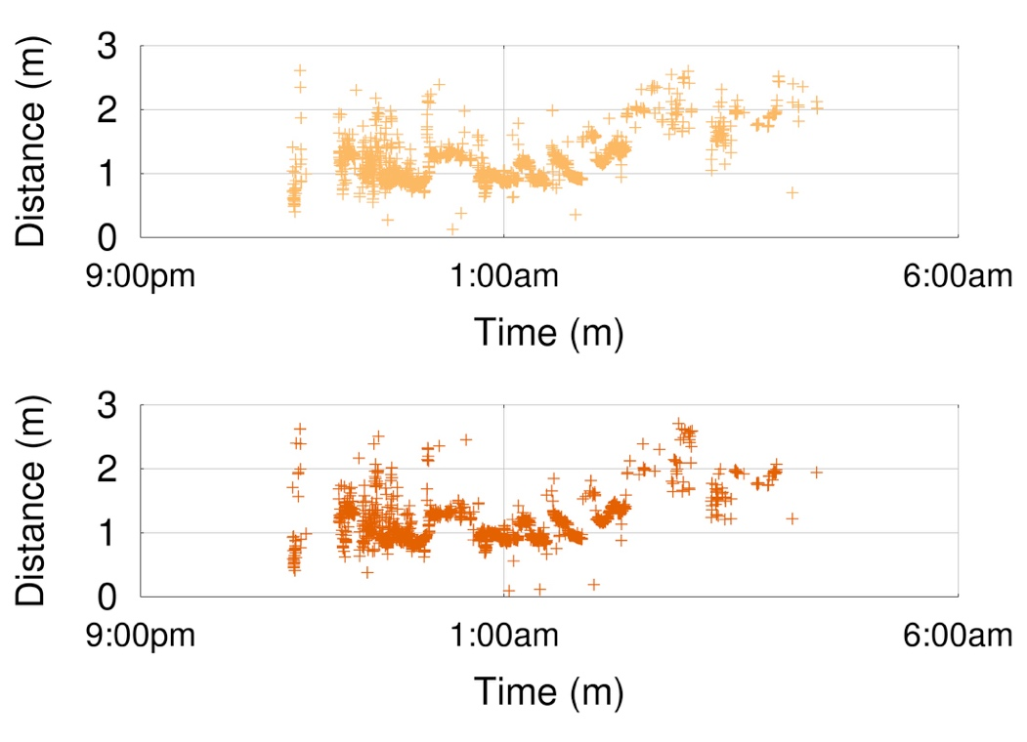
Opo: Forgoing absolute location for high fidelity relative location
Application
Human Interaction Tracking
Key Tradeoffs
Ranging Accuracy
Duration Accuracy
Usability
Opo
5 cm accuracy, 2 s minimum interaction, 93 hour battery life
Opo: A Wearable Sensor for Capturing High-Fidelity Face-to-Face Interactions (SenSys ‘14)
William Huang, Ye-Sheng Kuo, Pat Pannuto, and Prabal Dutta

Slide 44
Localization research needs to solve systems problems
If you believe in the IoT/IoE
100’s, 1000’s in one room?
Ground truth for anchors?
Anchors at all?
Localization technology as a privacy policy
SurePoint vs. Harmonium
vs. ALPS vs. Luxapose
10.00
Social fMRI [‘11/5.00]
Salathé [‘10/2.00]
WREN [‘13/2.00]
1.00
WASP [‘11/0.50]
Harmonia [‘14/0.40], RF-IDraw [‘14/0.38]
Accuracy (m)
PolyPoint [‘15/0.31]
SurePoint [‘16/0.29]
0.10
Tagoram [‘14/0.12], WiTrack [‘14/0.12]
Harmonium [‘16/0.09]
Opo [‘14/0.05]
0.01
3D-LOCUS [‘09/<0.01]
2008
2011
2014
2017
Time

Slide 45
Location technology maturing and will become commonplace
Today’s digital things have a few fundamental primitives
“Sense of Self”
“Sense of Time”
Tomorrow’s things will include a “Sense of where”
The long tail is full of interesting research
There are devices for whom a sense of time is difficult today
There will be those for whom location is difficult tomorrow
Drives novel systems and technological solutions

